Slide 1
Data Processing and Storage
CS3300 Data Science
RJ Nowling

Slide 2
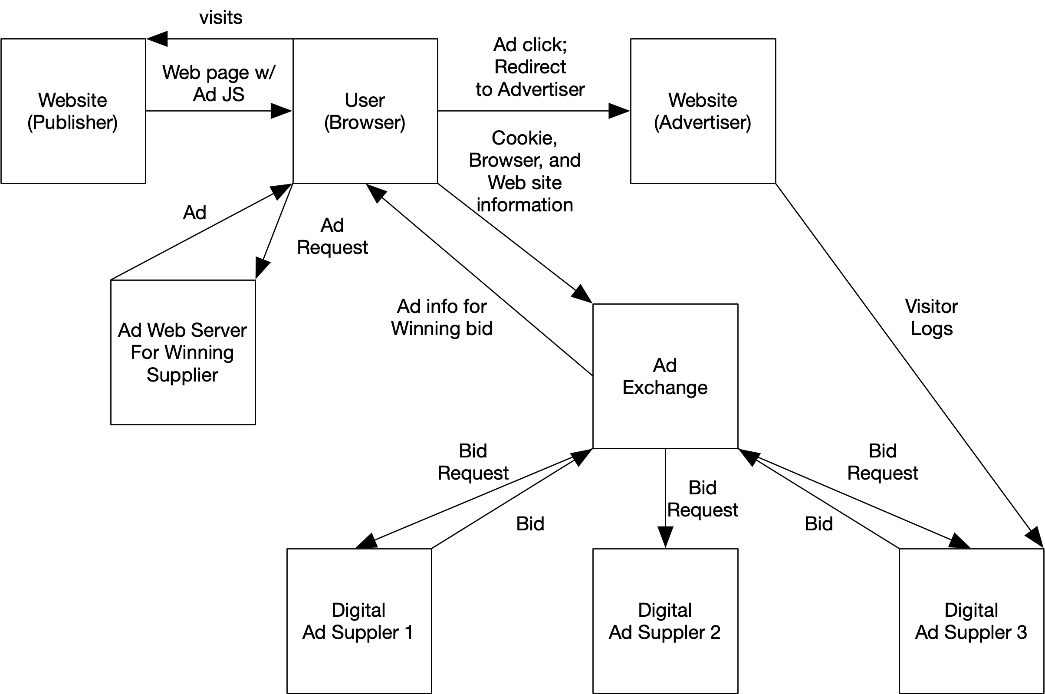
Real-Time Ad Serving

Slide 3
Data Collection Points
Bid Request
Bid (if any)
Logs of ads served
Advertiser visitor logs

Slide 4
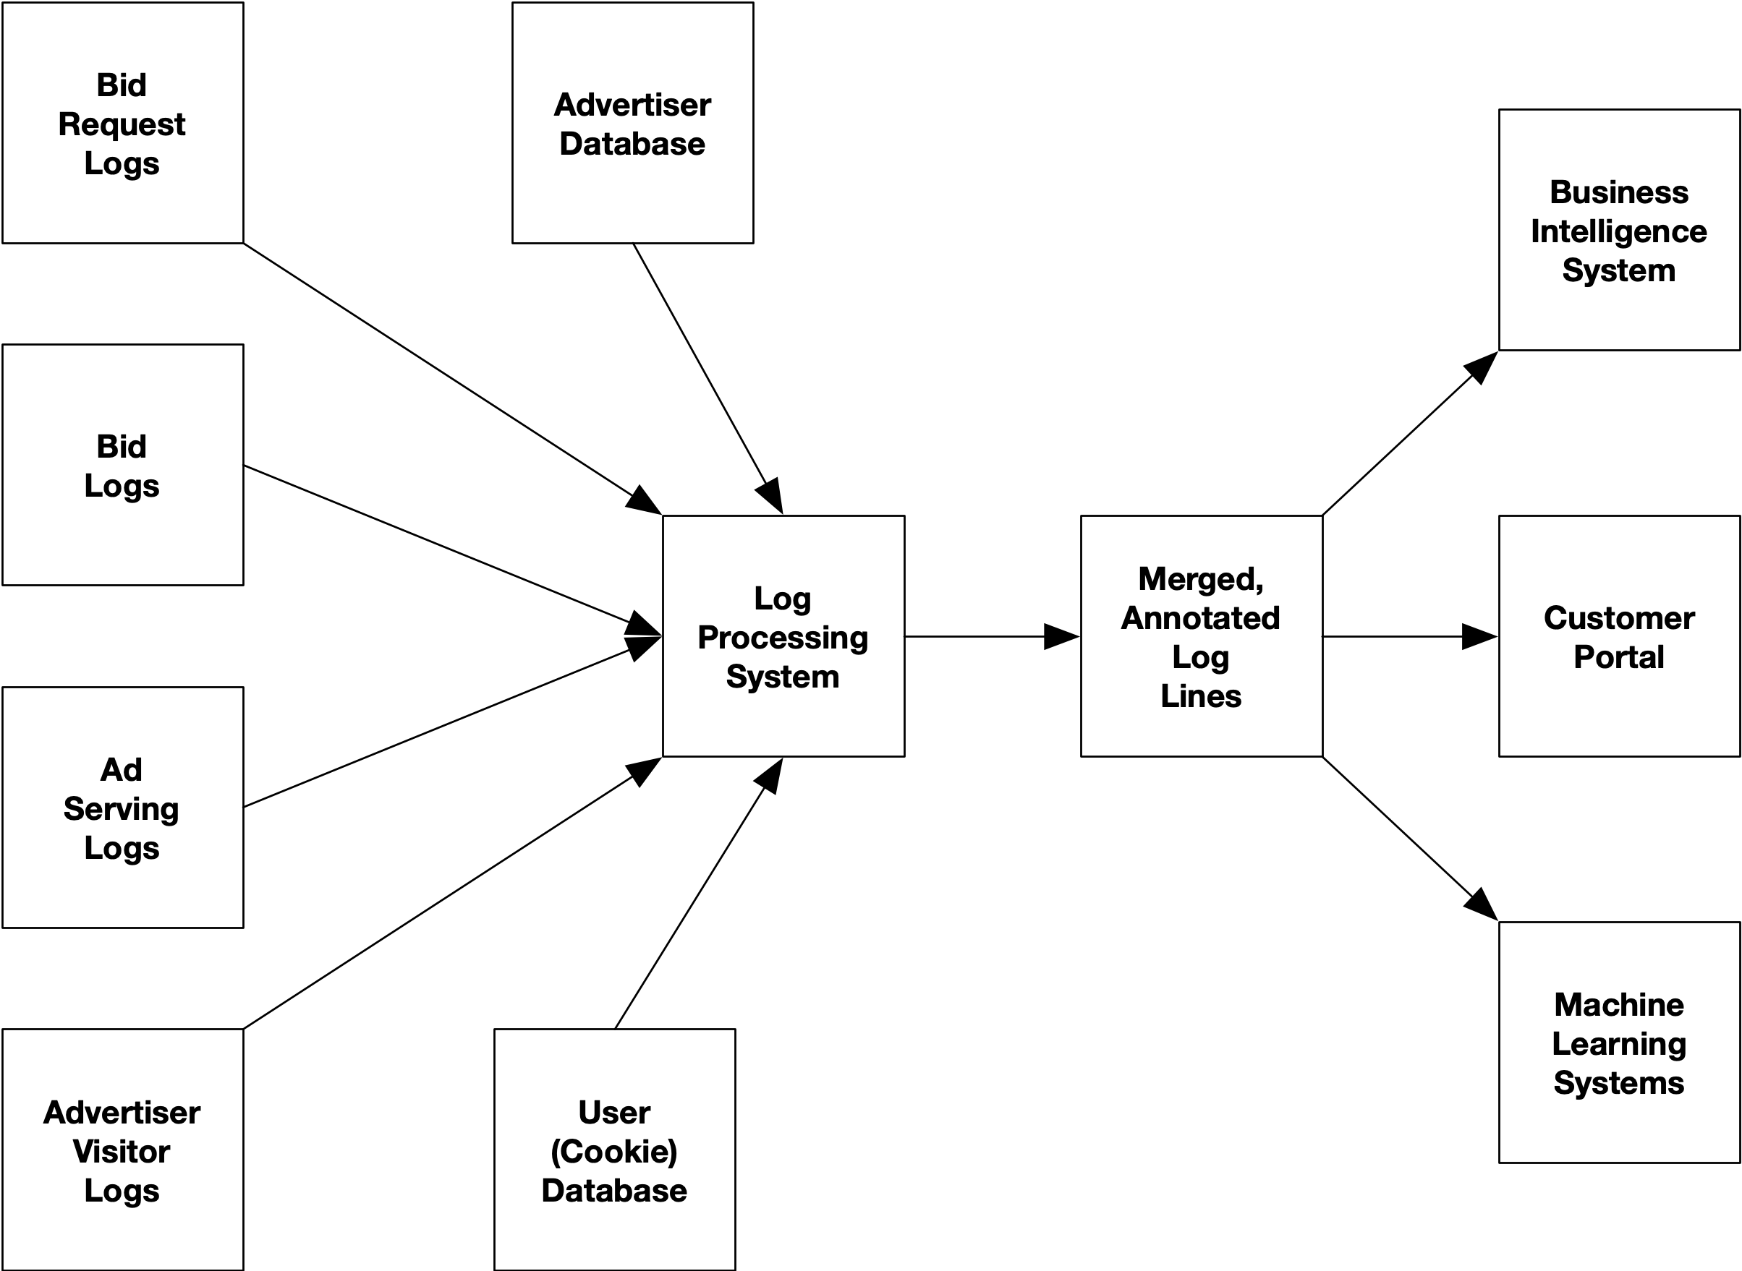
Log Processing

Slide 5
Customer Portal
Ad Cost Optimization
"Reach"
Cost per milli
Cost per click
Cost per acquisition
Number of unique, new, and repeat users by
ad views
ad clicks
ad acquisitions
Inferred user details:
Age, gender, income, etc. distributions
Geographic details

Slide 6
Managers and Executives
Ad Cost Optimization
Cost per milli – 99% percentile
Cost per click – 99% percentile
Cost per acquisition – 99% percentile

Slide 7
Machine Learning Teams
Ad Cost Optimization
Labeled Data for Ad Prediction Models
Cost per milli – 99% percentile
Cost per click – 99% percentile
Cost per acquisition – 99% percentile
Which bids do we win?
Which winning bids result in ad views?
Which ad views result in clicks (e.g., visits to advertiser sites)?
Which ad views result in acquisitions (e.g., purchases on advertiser sites)?

Slide 8
Data Ingestion and Cleaning

Slide 9
Spreadsheets and "Dark IT"
There is a tensions between an organization's desire to centralize data storage and enabling employees to get things done
If an employee wants to add new data to the data warehouse, they will have to:
File a ticket with IT or the data engineering team
Hope that IT or the data engineering team has the bandwidth to do the necessary work in a reasonable period of time
Spreadsheets are incredibly powerful business analysts to do a lot of basic data storage, cleaning, and analytics
Spreadsheets are widely used but usually very frustrating for IT

Slide 10
Data Processing Pipelines
Most enterprise data are "event" or time-based
Transactions (e.g., purchases)
Logistics updates (e.g., deliveries, shipping)
Data processing systems employ streaming or event-driven architectures
Events are processed as they arrive (streaming)
or in batches (e.g., every 24 hours)
Data pipelines :
Ingest raw data, output cleaned data
May combine with other data sources to annotate data
Update cumulative state in a relational database or similar

Slide 11
Two Common Approaches
Batch
Streaming
Data will be accumulated on some storage system
Pipelines are scheduled to run periodically (e.g., every 24 hours)
Easier to debug, operate
Large latencies
Data are processed as they arrive
Servers are running 24/7 to receive and process data
Low latency / near real-time
Harder to debug, operate
Not all operations are amenable to streaming data

Slide 12
Distributed Computing
"Big data" – when the data set is too large to process on a single machine
Technologies like Apache Hadoop and Apache Spark provide programming models that "hide" the details of where data is located and what each machine is doing
Every machine runs the same program on a separate subset of the data – move the program, not the data

Slide 13
MapReduce: Batch Processing with Commodity Hardware
Google's MapReduce was innovative because the creators realized that data could be analyzed efficiently using a cluster of commodity computers
Cheaper and faster than large, monolithic, and specialized solutions
If multiple machines try to load data from the same storage machine, you will quickly saturate disk and network bandwidth
To operate at full speed, data needs to be chunked up (partitioned) and divided across the cluster
To prevent data loss, each partition is stored on multiple machines (usually 3)

Slide 14
The Shot Heard Around the World
MapReduce was a relatively basic and proprietary design
Apache Hadoop is an open-source, reimplementation of:
MapReduce distributed computing system
Hadoop Distributed File System (HDFS) which allows data to be stored on a cluster of commodity servers as if they were a single machine
New and existing companies jumped on the bandwagon: Hortonworks, Cloudera, Pivotal, MapR, HP
Hadoop became the "standard" as companies hoped that collecting any and all data would magically lead to new business insights

Slide 15
Hadoop Weaknesses
Hadoop is not great for complex pipelines with many transformations
The programming model is very primitive
Requires loading and storing data after every transformation
Great for scalability… horrible for throughput
Specifically, not a great fit for machine learning
Hadoop ecosystem is incredibly modular, fragmented, and highly duplicated

Slide 16
Apache Spark
Machine learning started to become interesting to companies
Training a ML model requires many iterations
Graduate students at UC Berkeley dreamed up Resilient, Distributed Datasets
Think of them as Java ArrayLists but distributed over multiple machines
Programmer controls when data is kept in memory and when it is saved
By keep the data in memory, complex pipelines are much faster
Released their system as open source

Slide 17
Apache Spark Benefits
Spark grew into an all-in-one swiss army knife:
RDD API for "low level" operations
SQL API – familiar interface helps with adoption
MLLib – library for machine learning on large data sets
Streaming – API for writing continuously-running pipelines that act on streaming data
Compatible with notebooks (e.g., Jupyter)
By keeping data in memory, Spark disconnected compute and storage:
Data lives in AWS S3 or Google Cloud Storage
Only pay for cloud VMs when you need to process data
Multiple deployment options: On-premise, cloud, or as a service

Slide 18
Apache Spark Weaknesses
Spark is written in Scala
While other languages (e.g., Python, R, and Java) are supported, they are second-class citizens
Spark is complicated to debug and tune for performance
The ML library:
Model implementations are not very robust
Distributed model introduces communication latency; often better with "online" learning algorithms (e.g., see VopalWabbit)
No native GPU support -- world is moving towards deep learning

Slide 19
Other Big Data Platforms
Apache Flink
H2O
Apache Samza
Storm
Message Brokers / Queues
Apache Qpid
Apache ActiveMQ
RabbitMQ
Distributed Streaming Platforms
Confluent / Apache Kafka
Vectorized Redpanda
Apache Pulsar

Slide 20
Data Storage

Slide 21
Structured vs Unstructured Data
Semi-structured
Structured
JSON
CSV files
Generally semi-structured data becomes more structured as the it goes further down the data pipelines
Tables of data
Each row is a sample
Each column is a variable
Variables have well-defined types (e.g., ints, Strings)
Relational constraints
Unstructured
Text data (e.g., user reviews)
Images

Slide 22
Data Storage Technologies: File Systems
Local File Systems
Remote File Systems
Network File System (Linux and Unix OSs)
Server Message Block (SMB) (Windows, Linux, MacOS)
Distributed file systems
Hadoop Distributed File System (HDFS)
POSIX-compatible (e.g., Gluster, PanFS)
AWS S3 object store
Ceph

Slide 23
Data Serialization Formats
Implicit Schema
Explicit Schema
Columnar text files (e.g., CSV)
JSON
YAML
Excel spreadsheet
XML
Google Protocol Buffers
Parquet
Avro

Slide 24
Data Types (Schema)
Relational databases are what we would call "schema on write"
The schema is defined set up ahead of time
Data has to conform to this schema to be stored
Easier to analyze later but less flexible for adding new data or changes in data
JSON and other more flexible storage formats are called "schema on read"
No two records in a JSON file have to have the same fields or types of those fields
Very flexible for changing schemas over time
A lot of effort needs to be invested when accessing and analyzing the data to clean it

Slide 25
Tabular Text Files
Plain text
One record per line
Fields are separated by commas (CSV) or tabs (TSV)
Fields may be quoted (with double or single quotes) – used when fields contain commas or newlines
Since the type of a given column is not specified or enforced, the types of fields are often interpreted incorrectly and need to be manually fixed
Timestamp,Blood Glucose,Prior Activity
2016-05-07 08:05 PM,202,
2016-05-07 09:04 PM,237,
2016-05-07 10:15 PM,215,
2016-05-08 07:14 PM,228,
2016-05-09 04:19 AM,210,
2016-05-09 08:36 AM,246,
2016-05-09 12:47 PM,207,
2016-05-10 08:09 AM,248,
2016-05-11 12:09 AM,324,
2016-05-11 09:00 AM,244,
2016-05-12 02:14 PM,196,
2016-05-12 04:03 PM,125,Biking

Slide 26
JavaScript Object Notation (JSON)
A subset of JavaScript used to describe hierarchical data
Types: String, float, array, object (dictionary)
Object field names must be strings, values can be of any type
Each JSON files starts with a top-level object
{"to": "the00@speedy.uwaterloo.ca", "from": "\"Tomas Jacobs\" <RickyAmes@aol.com>",
"subject": "Generic Cialis, branded quality@ ",
"body": "\n\n\n\n\n\n\nDo you feel the pressure to perform and not rising to the occasion??\n\n\n\n\nTry Viagra.....\nyour anxiety will be a thing of the past and you will\nbe back to your old self.\n\n",
"user-agent": "Microsoft Outlook Express 6.00.2600.0000",
"date": "Sun, 08 Apr 2007 21:00:48 +0300",
"label": 1}

Slide 27
Relational Databases
MySQL, PostgreSQL, Microsoft SQL, Oracle
Relational databases store tabular data
Data organized into tables
Each row is a record
Each column is a variable with a strict type (e.g., real, integer, text)
Records in one table can reference records in another table (relational)
One to one
One to many
Many to many
Enforced by database management system
Data manipulated using the SQL language

Slide 28
Other Databases
Key-value and object stores (NoSQL)
Redis
MongoDB
Apache Cassandra
Timeseries databases
InfluxDB
Materialize
Kx kdb+
Distributed SQL Query Engines
Presto
Apache Drill
Apache Impala
Apache Hive

Slide 29
Normalized or De-normalized?
In theory, relational database schemas should be normalized
Reduces repetition of data
Avoids inconsistencies
Data spread across multiple tables
Normalized data often needs joined before being analyzed
Joins are slow
For cases where speed is an issue, data might be stored with a de-normalized schema

Slide 30
Read Only vs Read and Write
SQL has proven useful for analytics
But many RDBMs are optimized to ensure consistency of the data
Support many small queries in parallel
Ensure that no two queries write to the same record at same time (transactions)
Slow for large queries
Read-only SQL systems are designed to support very large queries running in parallel on a cluster
Presto, Hive, Impala
Data is uploaded in batches

Slide 31
Operational vs Analytics Store
Analytics stores are designed for data science
Store as much data as possible
Flexible (normalized schema) to support nearly any type of query
Technology may be designed to run a small number of very large queries
Operational stores are designed as backends for web apps or other "online" systems
Store minimal amount of data
Data will be organized (potentially de-normalized schema) to support a few very specific queries and execute them quickly
Technology may be designed to run a larger number of small queries

Slide 32
Data Warehouses
Centralized, large databases with schemas for flexible queries
Data warehouses primarily exist for analytics (not operations)
An IT or data engineering team is usually responsible for operating the data warehouse:
Running and maintaining the storage system itself
Creating and maintaining data pipelines for ingesting, cleaning, and integrating data
Servicing requests for new data collection

Slide 33
Single vs Multiple Systems
Data is rarely ever stored in a single system
Technical reasons
E.g., relational databases are good at tabular data but not binary large objects (blobs) like images
Storage systems catered to specific use cases (e.g., operational vs analytics stores)
Organizational reasons
Teams generally try to limit the scope of their responsibilities – focus on their core mission
Dependencies between teams slow down execution

Slide 34
Data Warehouses
Data warehouses aim to:
Locate all the data in one place
Keep the data consistent and clean
Allow the organization to track all data, processes for data ingestion and cleaning, and who is responsible
In practice, large organizations may have multiple data warehouses or data engineering teams
especially true when mergers occurred

Slide 35
Data Analysis

Slide 36
Business Intelligence / Analytics
Basic Analytics
Advanced Analytics
Spreadsheets
SQL databases or processing engines
Dashboards using tools like Microsoft Power BI and Tableaux
Python / Jupyter notebooks
Apache Spark

Slide 37
General Considerations

Slide 38
Conway's Law
"organizations which design systems ... are constrained to produce designs which are copies of the communication structures of these organizations" – Marvin Conway
Just like large software projects, data storage systems will tend to be divided along organizational lines

Slide 39
Cost
Storage costs depend on:
Amount of data
The level of redundancy (e.g., avoid failures)
How long you intend to keep it
How quickly you need to access it
How often you will transfer the data

Slide 40
On-Premise or Cloud
Cloud is often more convenient
Use what you pay for
Wide range of services (e.g., databases, message queues, etc.) that do not need to be managed
Services are optimized and reliable
But there are downsides
Requires operational knowledge
Security concerns
You lose all your data when you run out of money

Slide 41
Security / Privacy
Who should have access?
What data should you collect?
Security is largely a trade off between:
Risk of a breach
Convenience
Cost

